Slide 1
Hands-on Cybersecurity with Wireless Robots and NetsBlox
Akos Ledeczi and Hamid Zare
akos.ledeczi@vanderbilt.edu
Gordon Stein, Ben Yett, Nicole Hutchins, Peter Volgyesi, Brian Broll, Miklos Maroti
Supported by the NSA, the NSF and Vanderbilt University

Slide 2
NetsBlox
The IDEA:
Add distributed programming capabilities to Snap!
Why?
The majority of computer applications we interact with are distributed
More relevant projects for students: increased motivation and engagement
Combine CS with other STEM disciplines
Enhance collaboration
Cool ☺
What does it enable?
Multi-player games and other distributed programs like texting, chat room, etc.
Access to the wealth of STEAM data on the Internet
Collaboration a la Google Docs: pair programming, group projects, etc.
Robotics and hands-on cybersecurity education

Slide 3
Workshop Agenda
Lecture: Introduction to distributed programming with NetsBlox
Demonstration: various apps using online data (Weather, Charts, Movies, etc.)
Demonstration: various apps using message passing (Shared whiteboard, games, etc.)
Break (5 min)
Lecture: Introduction to robot programming
Hands-on: Create a manual driving program
Break (5 min)
Lecture: Cybersecurity curriculum and resources
Hands-on: Encryption
Hands-on: Code breaking (time permitting)
Q&A

Slide 4
Resources
https://netsblox.org
Main NetsBlox website. Tutorials, videos, projects, papers, etc.
https://dashboard.netsblox.org
Teacher portal: create groups of students. Manage robot resources.
https://netsblox.org/cybersecurity
Cybersecurity resources.
https://netsblox.org/protected-assets
Cybersecurity password protected material (to prevent students getting the solutions)
Account: cpss2019
Password: robot_camp ← wrong password on handout!
NetsBlox Player app
Available on iTunes and Google Play
https://www.facebook.com/netsblox/
Follow us on Facebook

Slide 5
Collaboration
Code editing a la Google Docs
Pair programming
Group projects
What is synchronized?
Everything that does not change by running the program
Sprites and scripts
What is not synchronized?
Everything that change by running the program
The state of the stage and sprites (location, orientation, etc.)
Variable values
Users can work together on the program but each executes it on his/her computer independently

Slide 6
Distributed Programming Primitives
Simple but powerful abstractions:
Hide accidental complexities, but expose the fundamental concepts
Abstractions:
Remote Procedure Calls (RPC)
Message Passing

Slide 7
Remote Procedure Calls
RPC: call functions on the server
Multiple input arguments
One output argument
Blocking call
Grouped into services that wrap various web APIs
Google Maps, weather, earthquake, movies, stock quotes, etc.
Utilities running on the server
Plotting, cloud variables, etc.
Game management
Tic Tac Toe, Battleship, Hangman, etc.

Slide 8
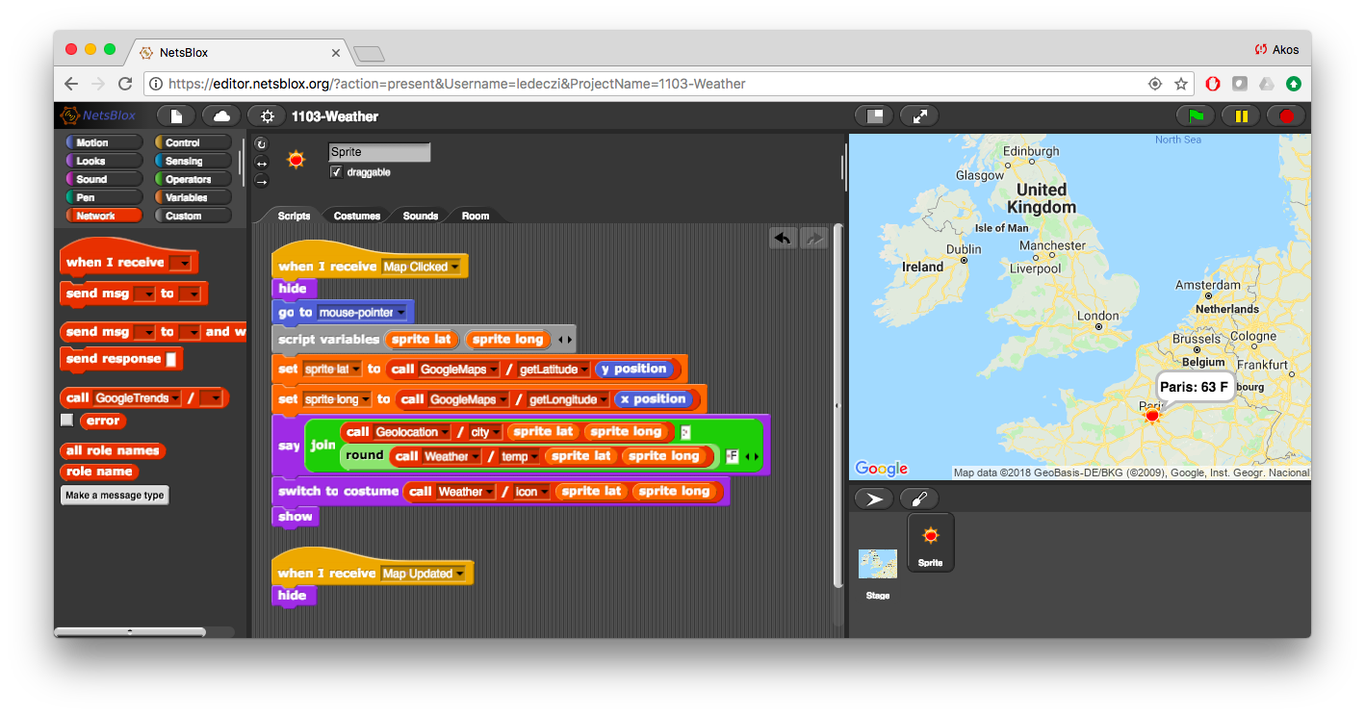
Demo: Interactive Weather App
Stage: Interactive Google maps background with zooming and panning
Sprite: Jumps to wherever the user clicks and displays current conditions with a weather icon and shows the name of the closest city and current temperature

Slide 9
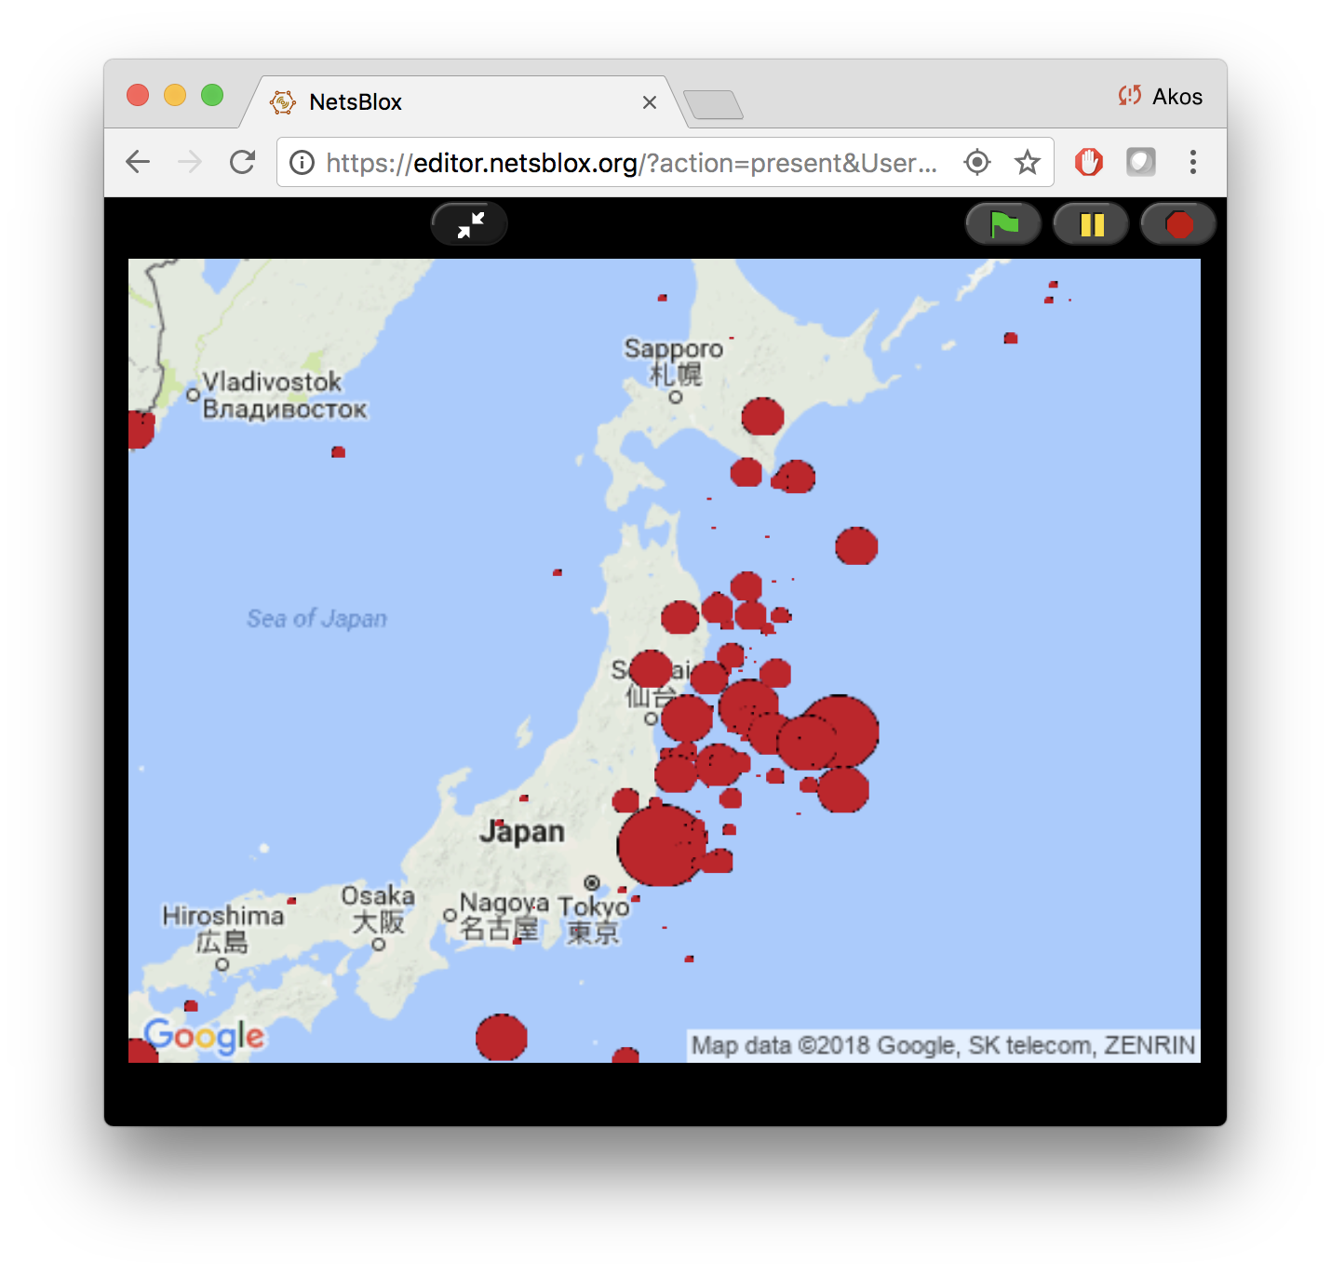
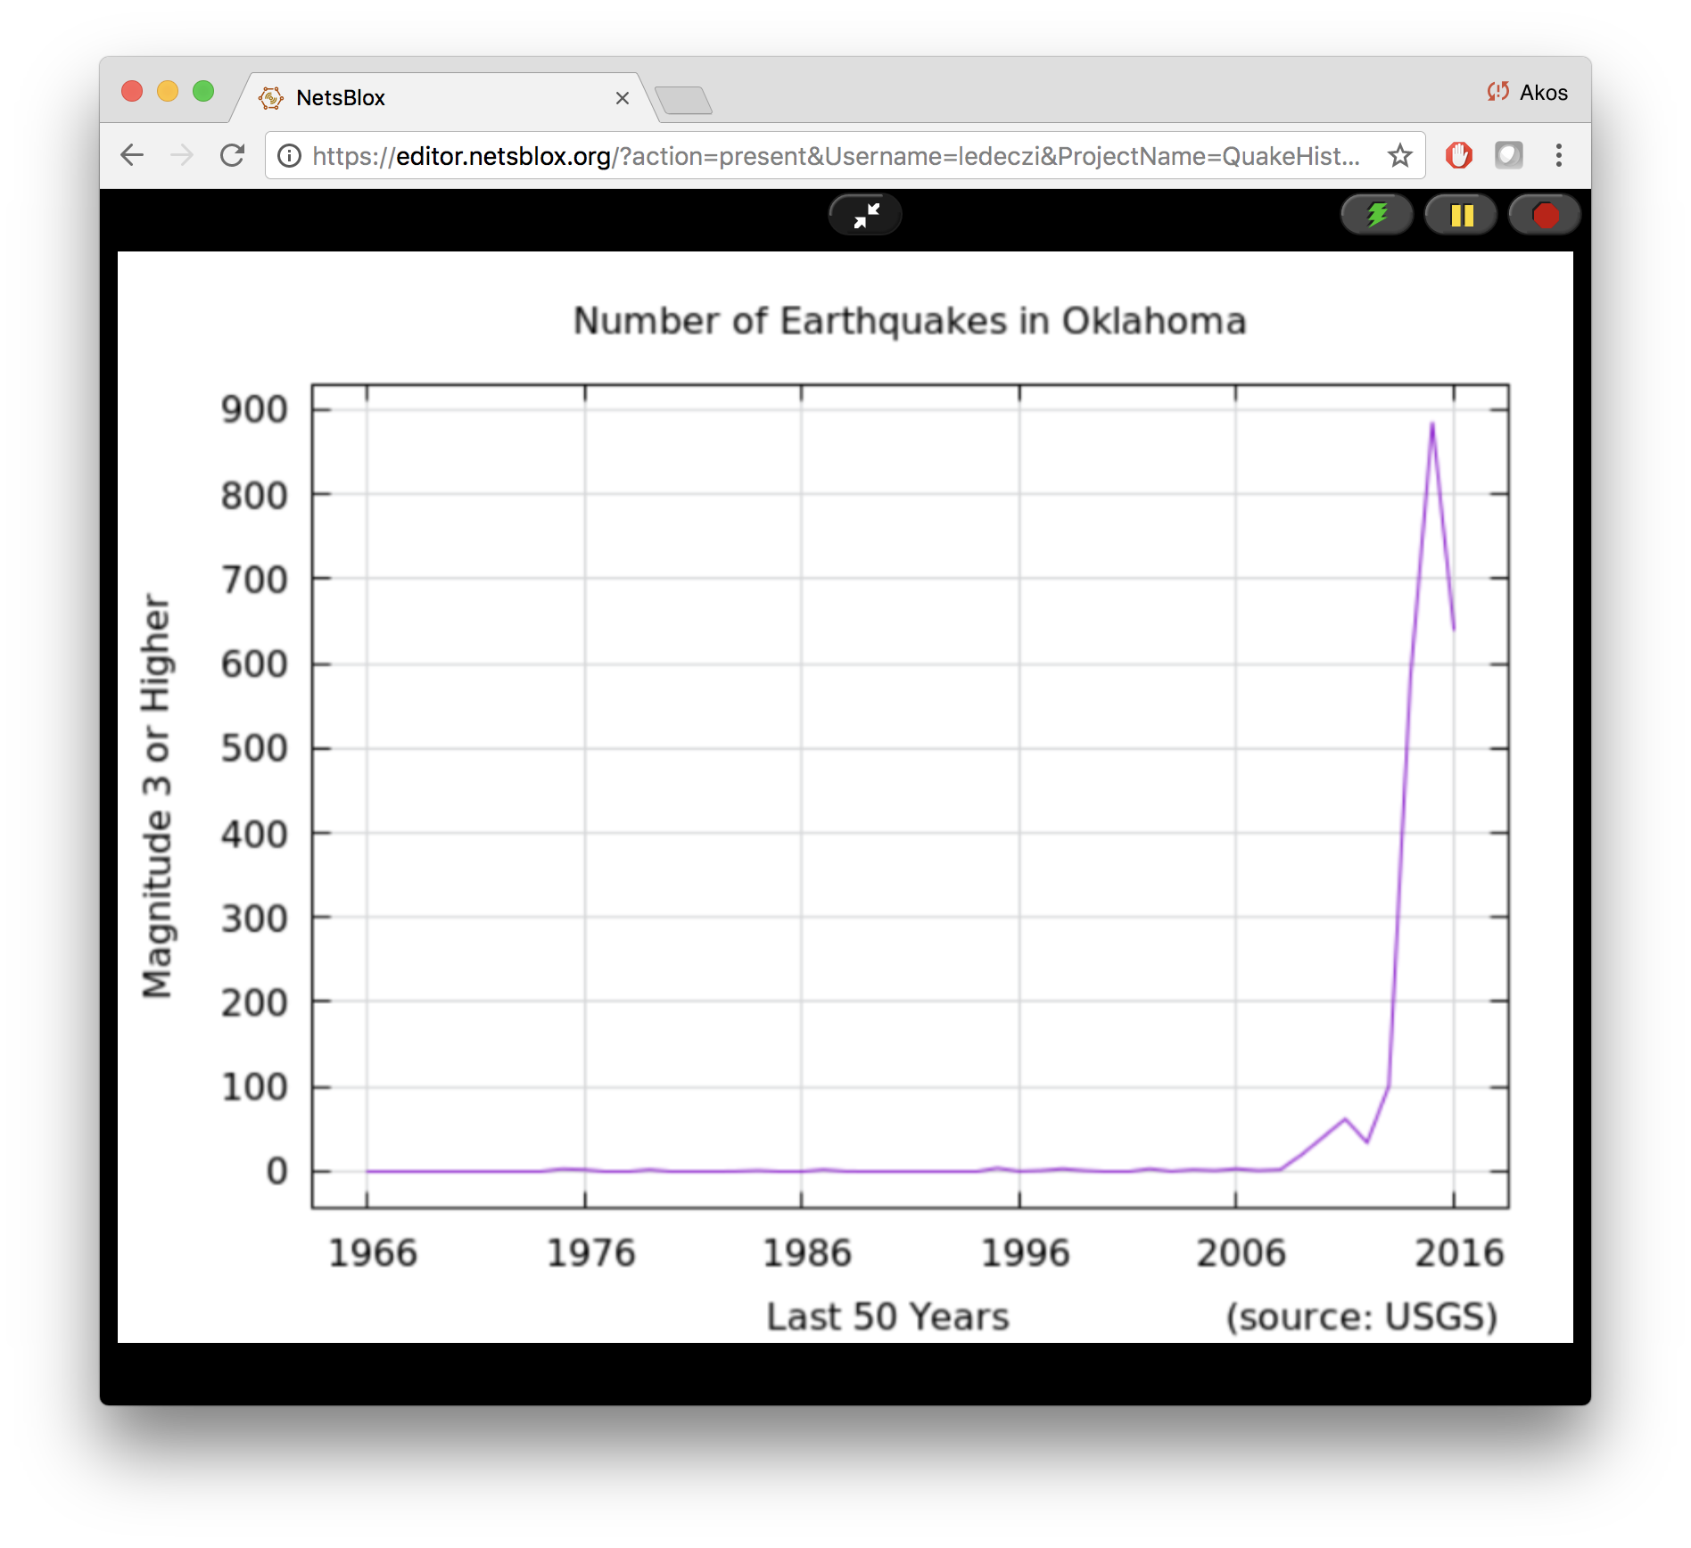
Additional RPC Demonstrations
Earthquakes for the past 10 years
3 leading cast members of any movie
Fracking?
Various other projects using online data sources and services

Slide 10
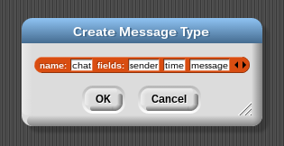
Message Passing
Similar to Events in Snap!
Carry data
Can go from one computer to another
Messages in NetsBlox (typed):
Message type editor:

Slide 11
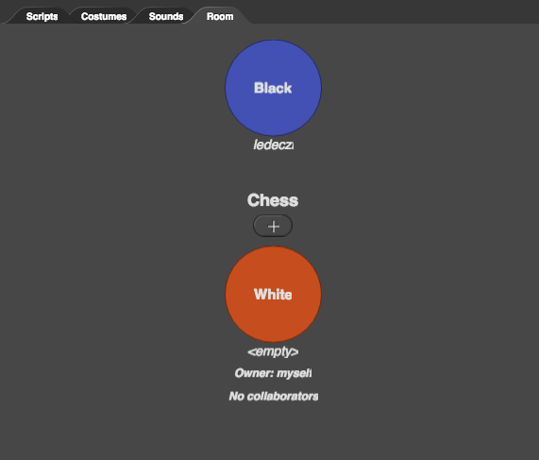
The Room
Set of roles/clients participating in the distributed application (subprojects)
Each role has its own set of sprites, stage and scripts
The owner invites other users to to run the project by “playing” a given role
Messages can be sent to these users (i.e., roles)
A new instance of the room is created for every new run of the application

Slide 12
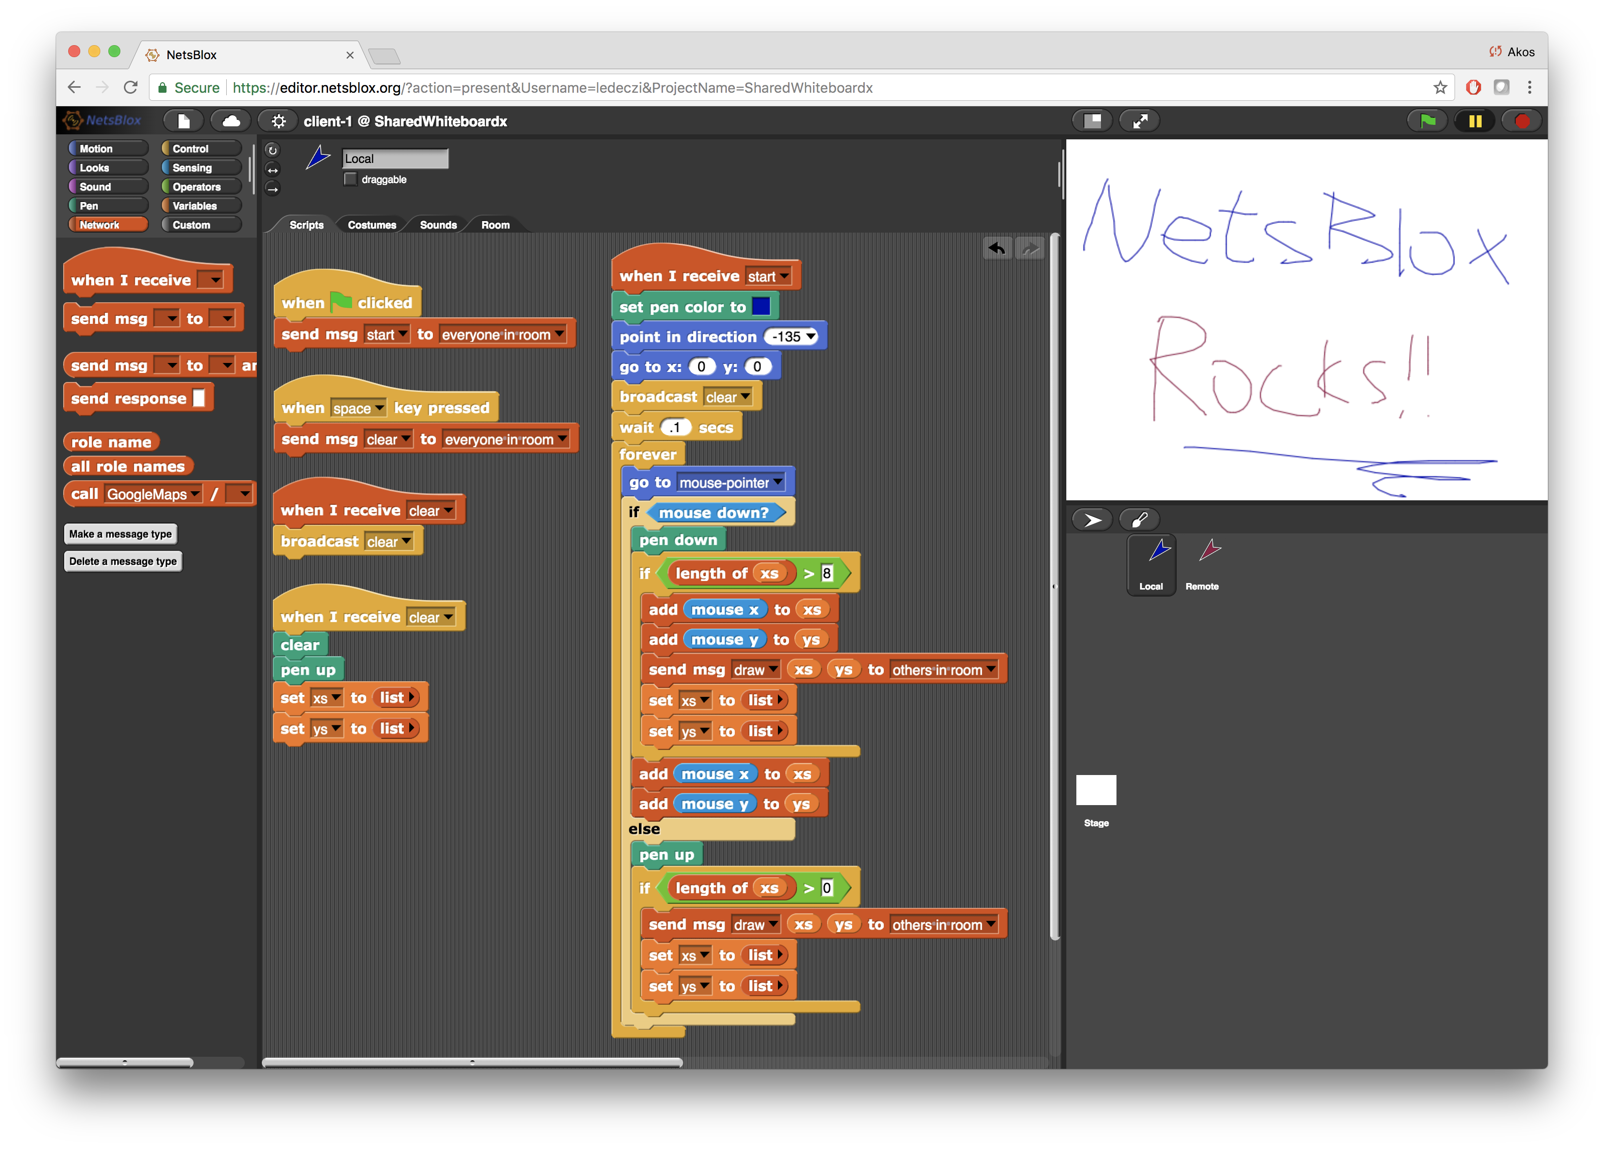
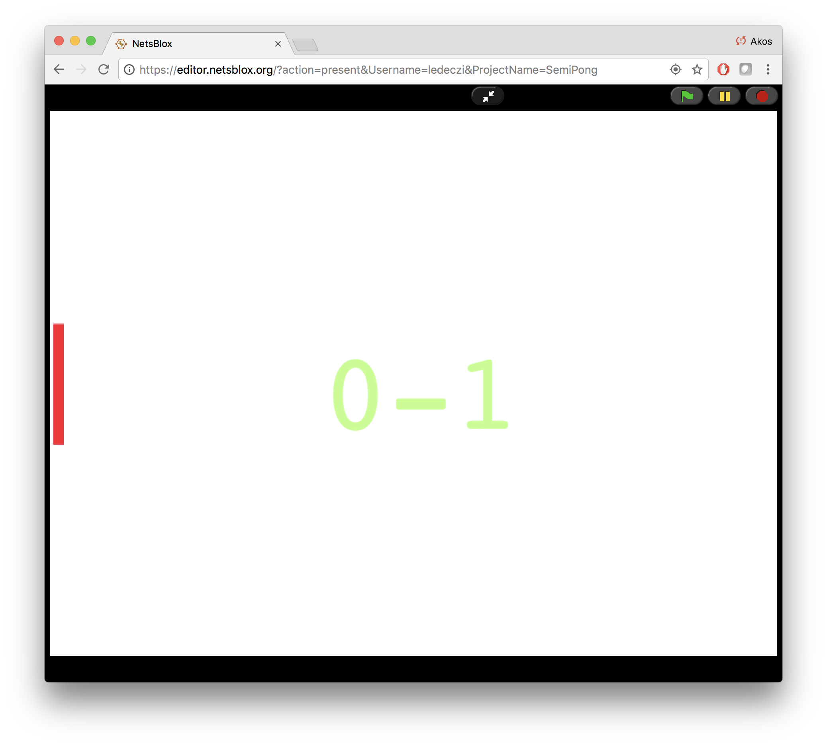
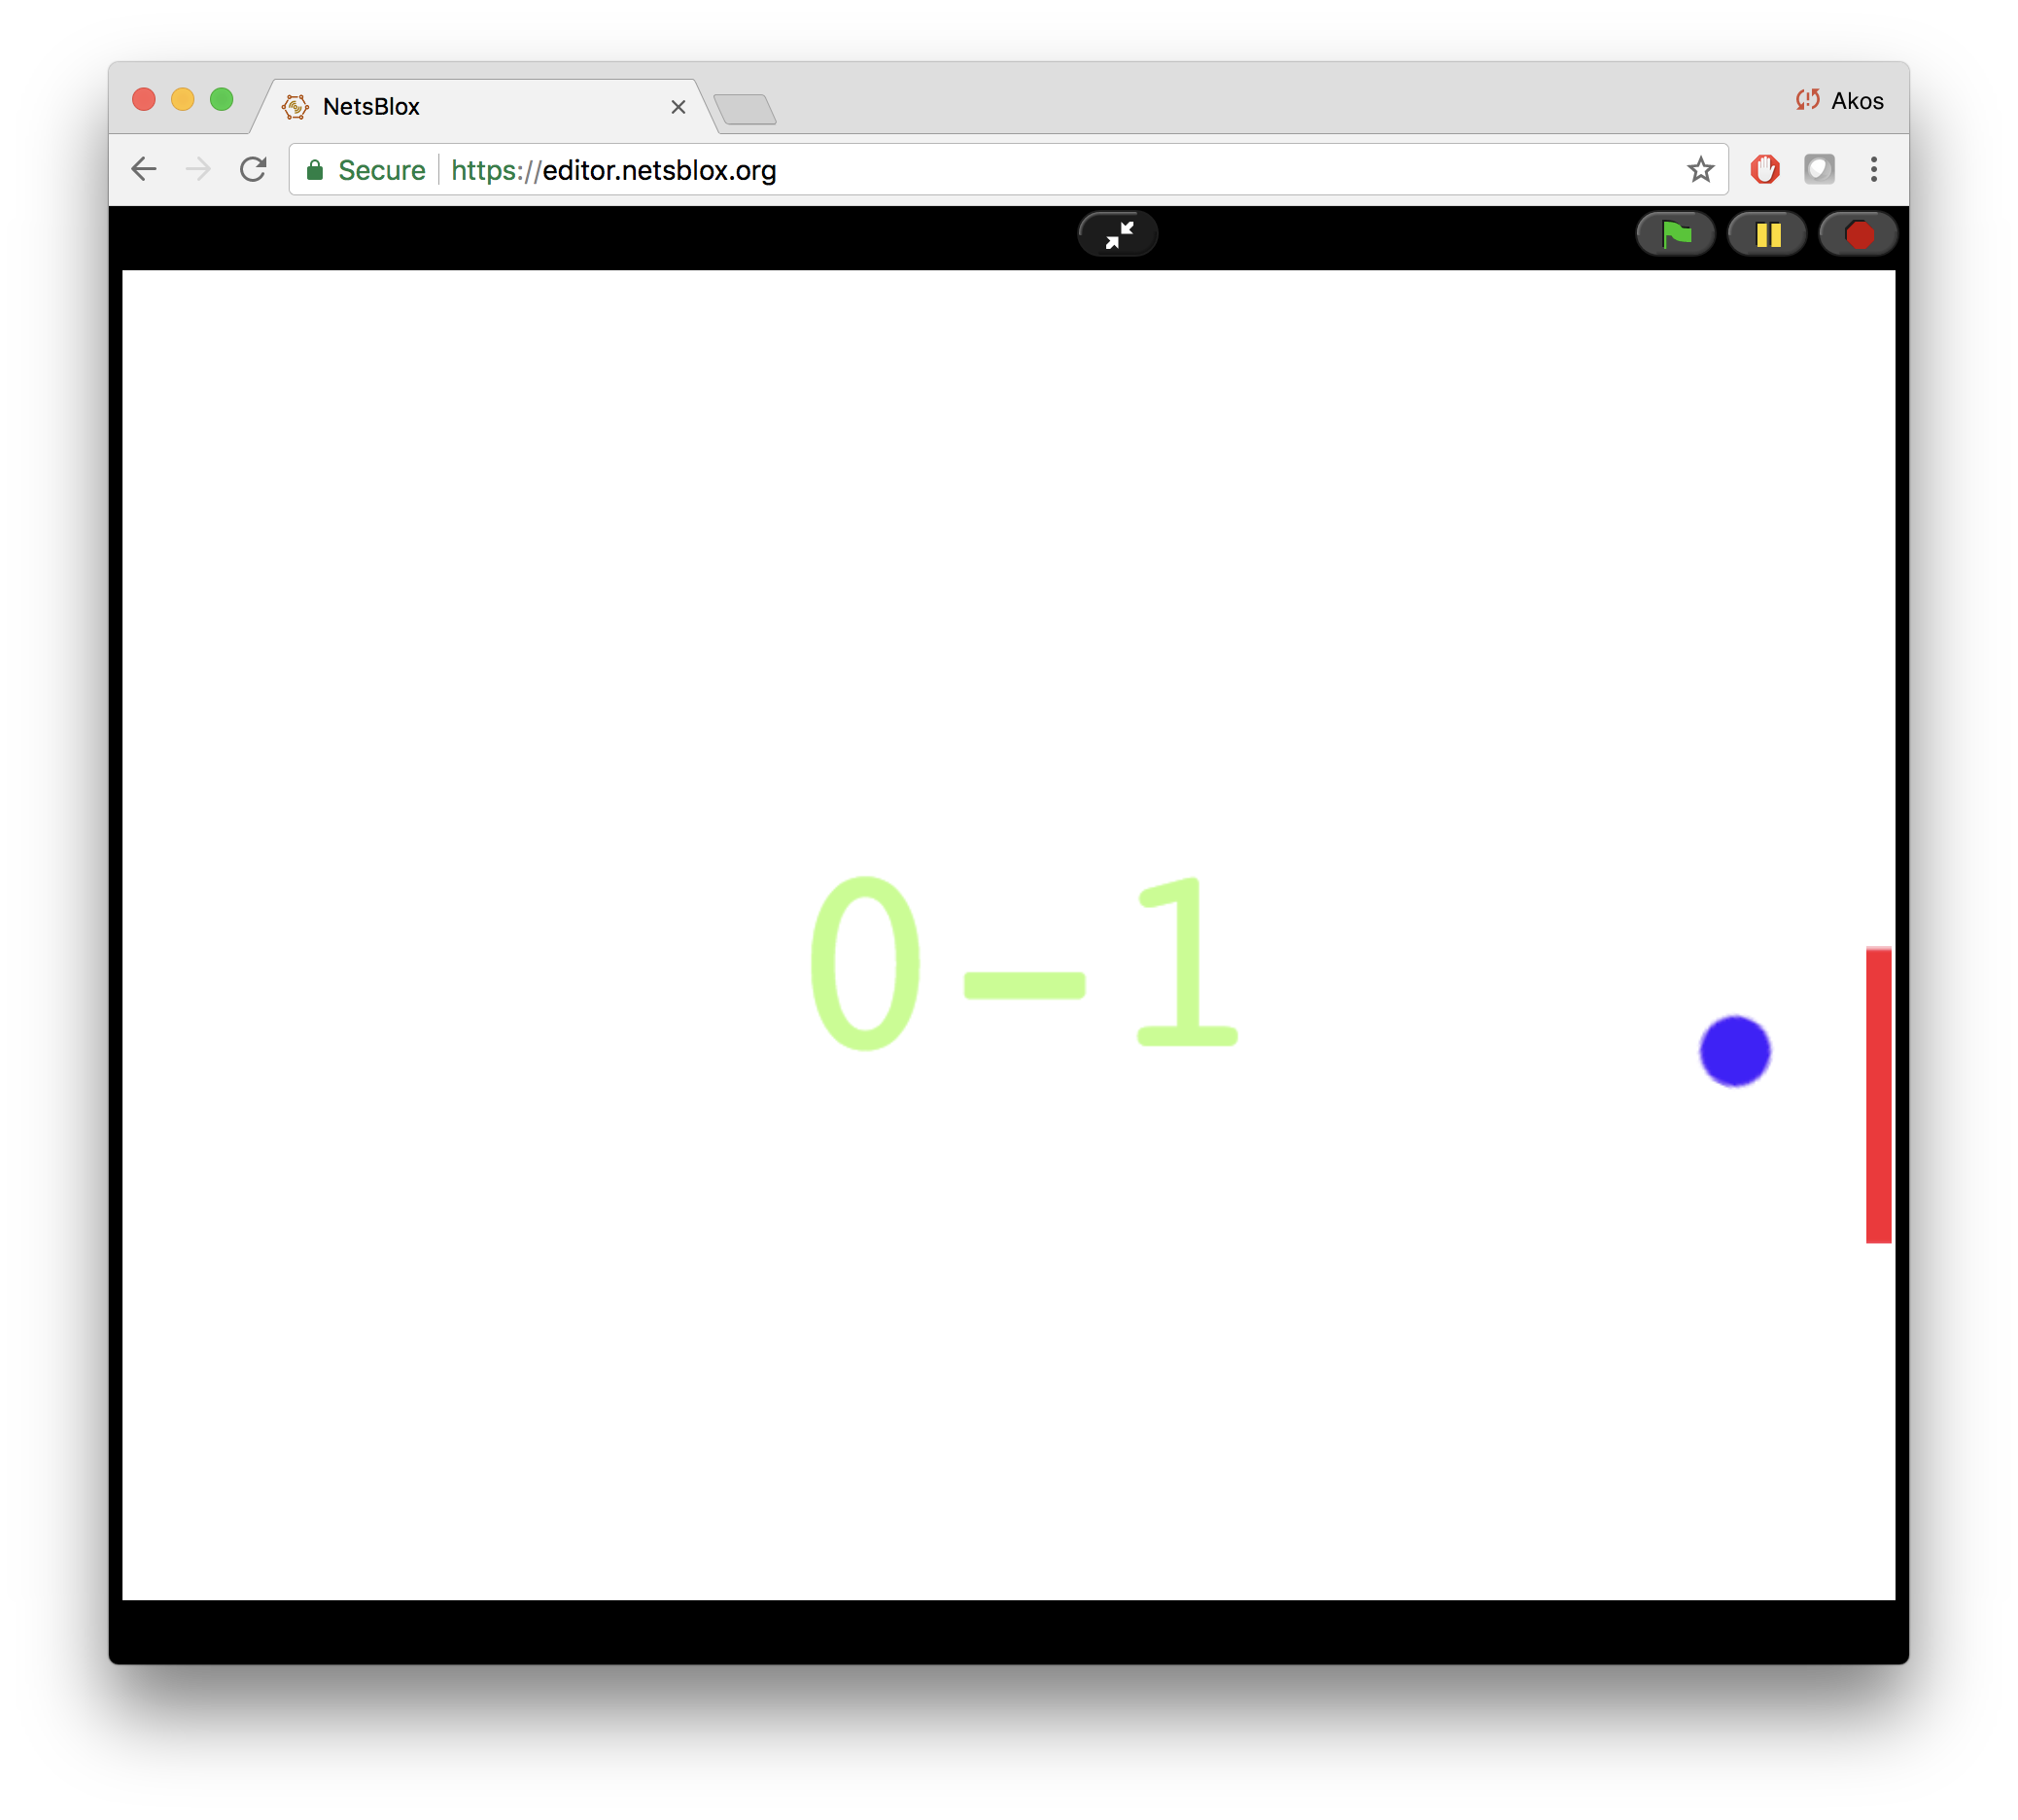
Message Passing Demonstrations
(Semi) Pong
Shared Whiteboard
Various distributed projects using message passing

Slide 13
BREAK

Slide 14
Robotics with a Difference
NetsBlox program runs in the browser
Uses RPCs to control the robots via WiFi
No wires, no need to download the program: just like programming a sprite
Robot sends messages back with sensor values
Robot commands are sent in the clear, can be overheard: Various cyber attacks and cyber defense techniques can be taught in a hands-on manner.
Robot driving competition where other students are allowed to cyber attack the current racer
Two summer camps last year and two last month: level of engagement was off the charts

Slide 15
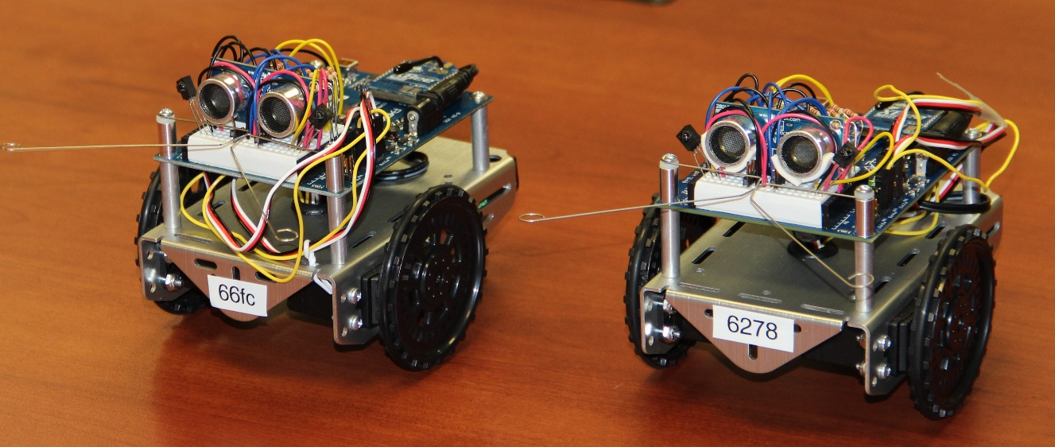
Parallax ActivityBot 360
WiFi enabled with an extra hardware module
MAC address used as unique ID (last four digits are enough)
Left and right wheel controlled independently
Sensors:
Ultrasonic range
Optical wheel encoders
Touch sensors (whiskers)

Slide 16
Tips and Tricks
Blue LED blinks: WiFi is connected
Main switch has three states: OFF, everything but the motors ON, ON
If you have the robot on the table, do NOT turn the motors ON please!
Batteries can sometimes fall out, wires can come loose…
Communication can be unreliable: commands can be lost sometimes.
Write robust programs!

Slide 17
Robot WiFi Setup: Plan B
Robots could not connect to conference WiFi
Open network with extra authentication step required
Local copy of the NetsBlox server running on Raspberry Pi
Connect your laptops to
SSID: robonet
Password: cybercamp
We have never tried it with 50+ people, so let’s hope for the best ☺
NO INTERNET ACCESS
Do not try any of the other services, RPCs
If you want to save you programs for after the workshop, you need to export the project
Go to this url: netsblox.local/ (or 192.168.1.111)
UserN and pwdN where N is a number and I’ll assign it now…

Slide 18
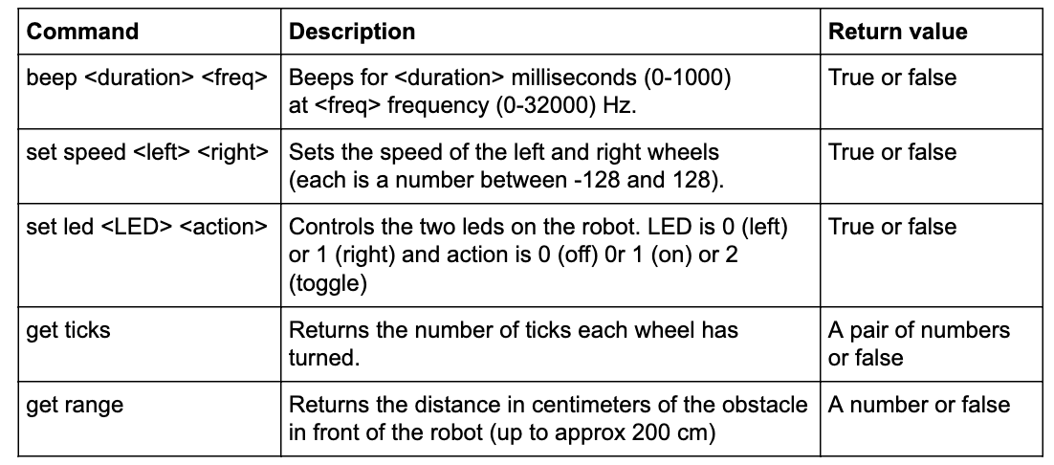
The RoboScape Service

Slide 19
Task: Manual Driving
Initialize your robot address
Emergency STOP command:
Task: Use the arrow keys to drive your robot around

Slide 20
Collaboration, Saving and Backing Up
Collaboration:
Invite your partners: Cloud menu/Collaborators
Accept invitation and open project
Owner: project shows up as expected
Collaborators: project shows up in “Shared With Me” tab
Glitch: sometimes projects can get out of sync. Save correct version. Others should reload webpage and try to open project again. Make frequent backups!
Save projects:
Make sure to save your project regularly with File menu/Save
Local backup:
File menu/Export project: created local XML file
You can import these, or simply drag and drop

Slide 21
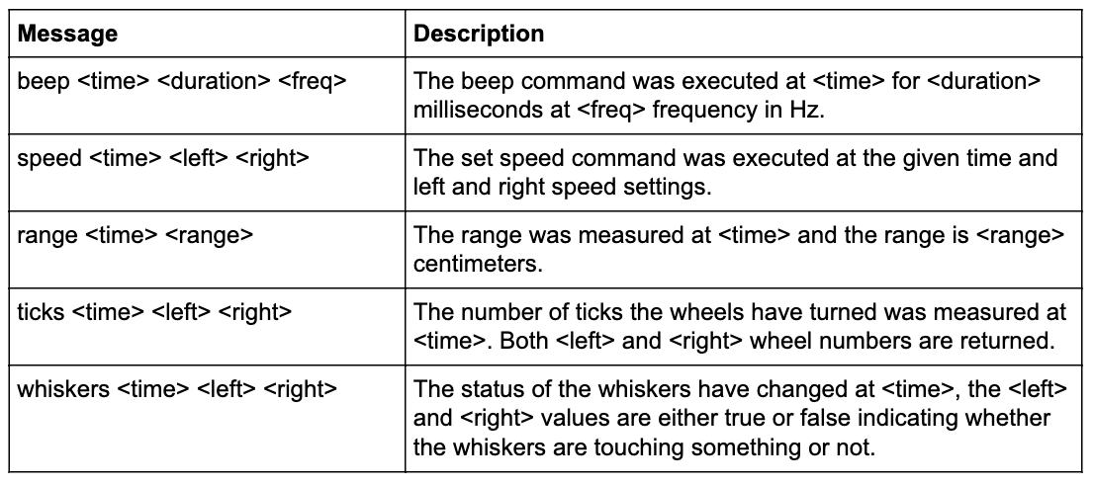
Robot Messages
Register to receive messages
Every command sent to the robot is echoed back to all listeners. (File menu: Import Services: RoboScape)
Robot sends acknowledgements of all executed commands with a timestamp and returns sensor values as well.

Slide 22
Task: Obstacle Detection
Hints :
Task: Backup when an obstacle is touched

Slide 23
BREAK

Slide 24
Resources
https://netsblox.org
Main NetsBlox website. Tutorials, videos, projects, papers, etc.
https://dashboard.netsblox.org
Teacher portal: create groups of students. Manage robot resources.
https://netsblox.org/cybersecurity
Cybersecurity resources.
https://netsblox.org/protected-assets
Cybersecurity material (password protected to prevent students from getting the solutions)
Name: cpss2019
Password: robot_camp ← wrong password on handout!
RoboScape robot configurator app (Android only)
Setup WiFi SSID and password (2.4 GHz only)
Claim ownership of robots (use dashboard for further management)

Slide 25
Cybersecurity
How is RoboScape unsecure?
All communication is open
If you know the robot address, you have full access
Intentional and “faked:” we are not actually intercepting WiFi messages
Motivates cybersecurity:
Denial of Service attack
Encryption
Code breaking
Secure key exchange
Replay attacks
Week-long cybercamp
~30 hours (intensive, could be extended 2-3x easily)
No programming background assumed

Slide 26
Cybercamp
Day 1: Introduction to programming with NetsBlox (including RPCs and messages).
Day 2: Introduction to programming robots with NetsBlox. Manual driving with keyboard arrow buttons. Race on an obstacle course. Self-driving: drive around a square.
Day 3: Simple cyber attacks. Attack detection. Distributed Denial of Service attacks. DDS mitigation. Upgrade manual driving and self driving programs so that they are resistant to DDS attacks.
Day 4: Brief introduction to cryptography. Caesar’s cypher. Upgrade manual driving and self driving programs so that they use encryption. Brute force code breaking. Key theft.
Day 5: Secure key exchange. Replay attack. Sequence numbers. Upgrade manual driving and self driving programs so that they use more advanced encryption with hardware key and sequence numbers. Manual driving race with other teams; free to cyber attack robot.

Slide 27
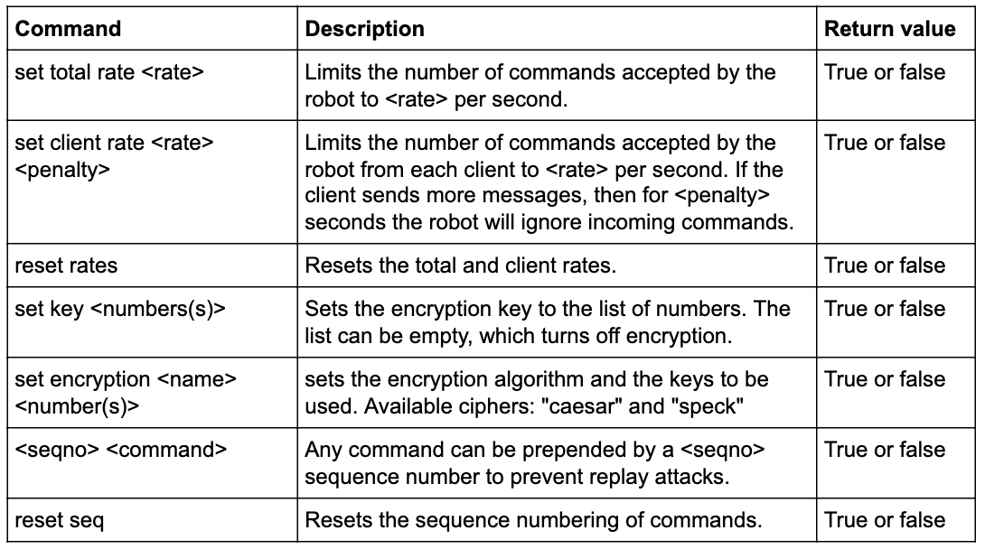
Advanced Robot Commands

Slide 28
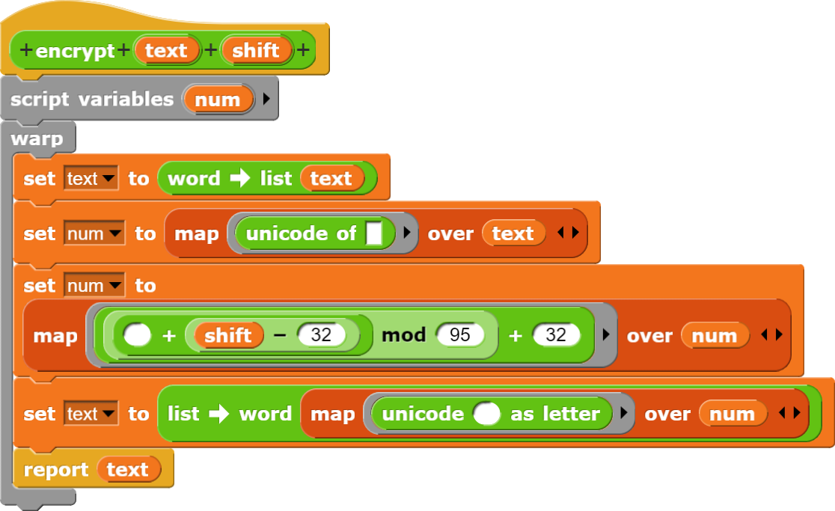
Encryption
Caesar's cypher
Custom blocks provided
File menu: Import Services: RoboScape
Possible key values: 0-94
Robot defaults to 0
Make sure the RPC succeeds!!!

Slide 29
Task: Add encryption
Tell the robot the key:
space
Create a custom block (optional):
You may want to create a reporter version for get range and get ticks as well
Decrypt all messages
Task: Update the manual driving program with encryption

Slide 30
Optional Task: Break the Encryption
?
Task: take control of somebody else’s robot (with permission!)

Slide 31
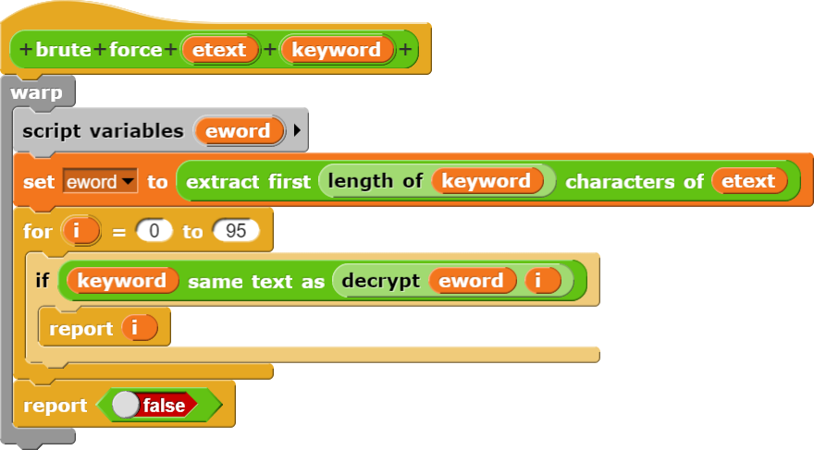
Brute Force Code Breaking
Look for one of the fixed keywords

Slide 32
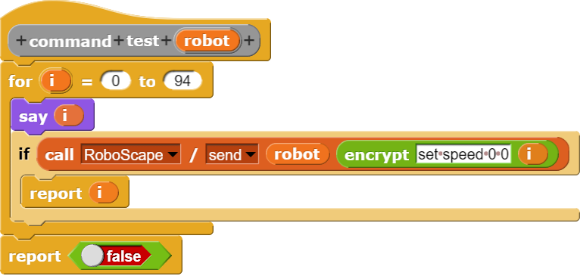
Brute Force Code Breaking
Test commands:

Slide 33
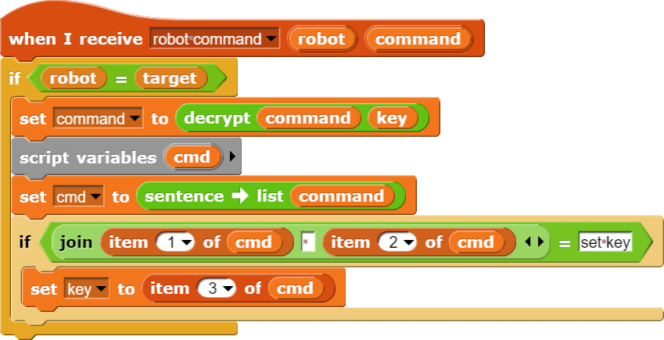
Key Theft
The first set key command is always unencrypted.
This code steals the key continuously:

Slide 34
Solution
Use stronger encryption:
Vigenère cipher: version of Caesar's with multiple keys
Speck by NSA (File menu: Libraries: Cypher)
Secure key exchange:
Pressing the button on the robot generates a sequence of 16 bits and blinks the LEDs accordingly
4 4-bit keys for Vigenère (or Speck)
Type in values. Key is never broadcasted unecrypted
No need for the set key command! But can be used later for periodically changing the key

Slide 35
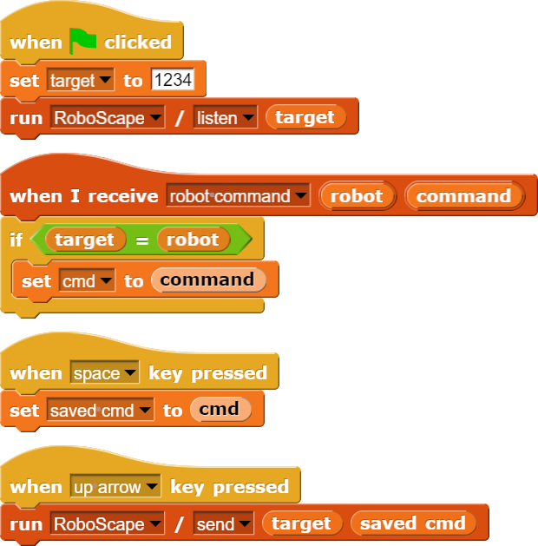
Replay Attack
Even if the attacker cannot break the encryption, they can still replay the last overheard command
Solution: sequence numbers:
The send command can be prepended by an integer: N
Once started, robot will only accept commands that start with a number M greater than the last one. Specifically:
N < M < N+100

Slide 36
Summary
NetsBlox opens the internet for students’ programs
Public data sources related to STEAM
Distributed programming/computer networking
Robotics and cybersecurity
Collaboration
Hands-on: learning by doing
More engaging projects increasing motivation
Allows for synergistic teaching of STEM and CT
High ceiling:
Can be used to teaching advanced topics that no other environment allows currently

Slide 37
Questions?
https://netsblox.org
https://netsblox.org/cybersecurity
Do not forget to fill out the evaluation!
Sponsors: National Security Agency, National Science Foundation and
Vanderbilt University

