Slide 1
Advanced CS Concepts in High School: One Tool to Rule Them All
Akos Ledeczi
akos.ledeczi@vanderbilt.edu
Brian Broll, Hamid Zare, Gordon Stein, Peter Volgyesi
Supported by the NSF, the NSA and Vanderbilt University

Slide 2
NetsBlox
The IDEA:
Bring distributed programming capabilities to a block-based environment
Why?
The majority of computer applications we interact with are distributed
Make projects more relevant: increased motivation and engagement
Combine CS with other STEM disciplines
Enhance collaboration
Cool ☺
What does it enable?
Multi-player games and other distributed programs like messaging, chat room, etc.
Access to the wealth of STEAM data and services on the Internet
Collaboration a la Google Docs: pair programming, group projects, etc.
Robotics and hands-on cybersecurity education

Slide 3
Resources
https://netsblox.org
Main NetsBlox website. Tutorials, videos, projects, papers, etc.
https://github.com/netsblox/netsblox
Open source software
https://dashboard.netsblox.org
Teacher portal: create groups of students. Manage robot resources.
https://netsblox.org/cybersecurity
Cybersecurity material
https://netsblox.org/protected-assets
Password protected cybersecurity material (to prevent students from getting the solutions)
Account: cpss2019
Password: robot_camp
NetsBlox Player app
Available on iTunes and Google Play
https://www.facebook.com/netsblox/
Follow us on Facebook

Slide 4
Create Account and Login
If you want to try out some of things we cover:
Go to netsblox.org
Click the cloud icon near the top left
Click register and follow instructions

Slide 5
Distributed Programming Primitives
Simple but powerful abstractions:
Hide accidental complexities, but expose the fundamental concepts
Abstractions:
Remote Procedure Calls (RPC)
Message Passing

Slide 6
Remote Procedure Calls
RPC: call functions on the server
Multiple input arguments
One output argument
Blocking call
Grouped into services that wrap various web APIs
Google Maps, weather, earthquake, movies, stock quotes, etc.
Utilities running on the server
Plotting, cloud variables, etc.
Game management
Tic Tac Toe, Battleship, Hangman, etc.

Slide 7
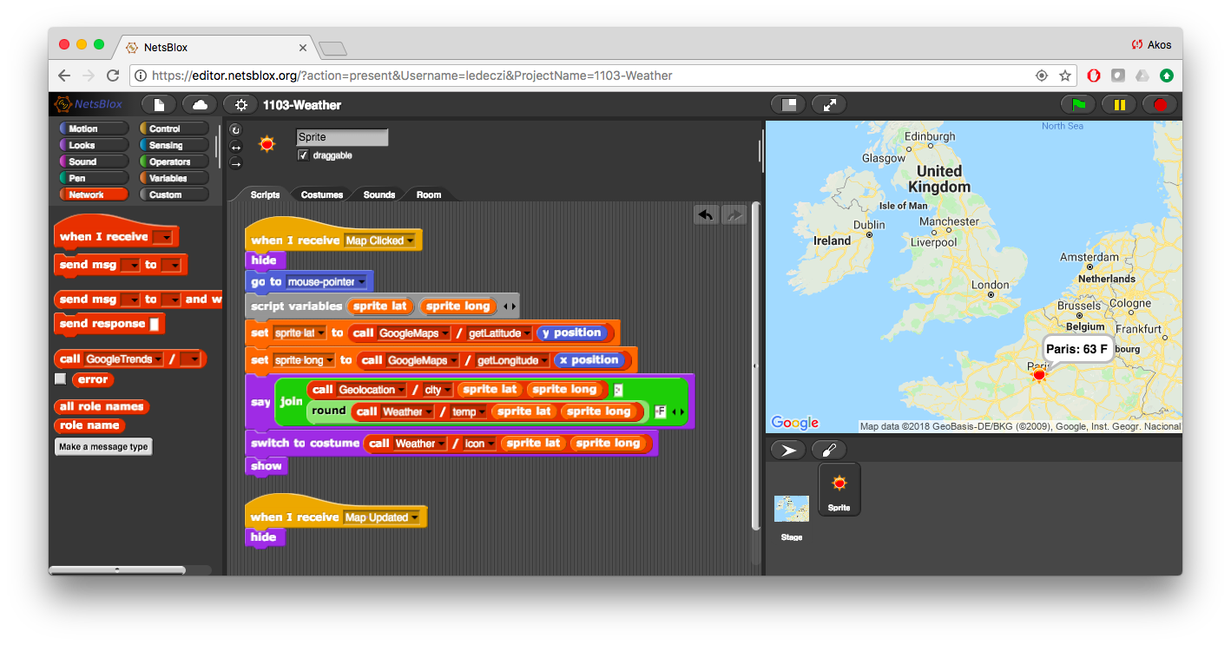
Demo: Interactive Weather App
Stage: Interactive Google maps background with zooming and panning
Sprite: Jumps to wherever the user clicks and displays current conditions with a weather icon and shows the name of the closest city and current temperature

Slide 8
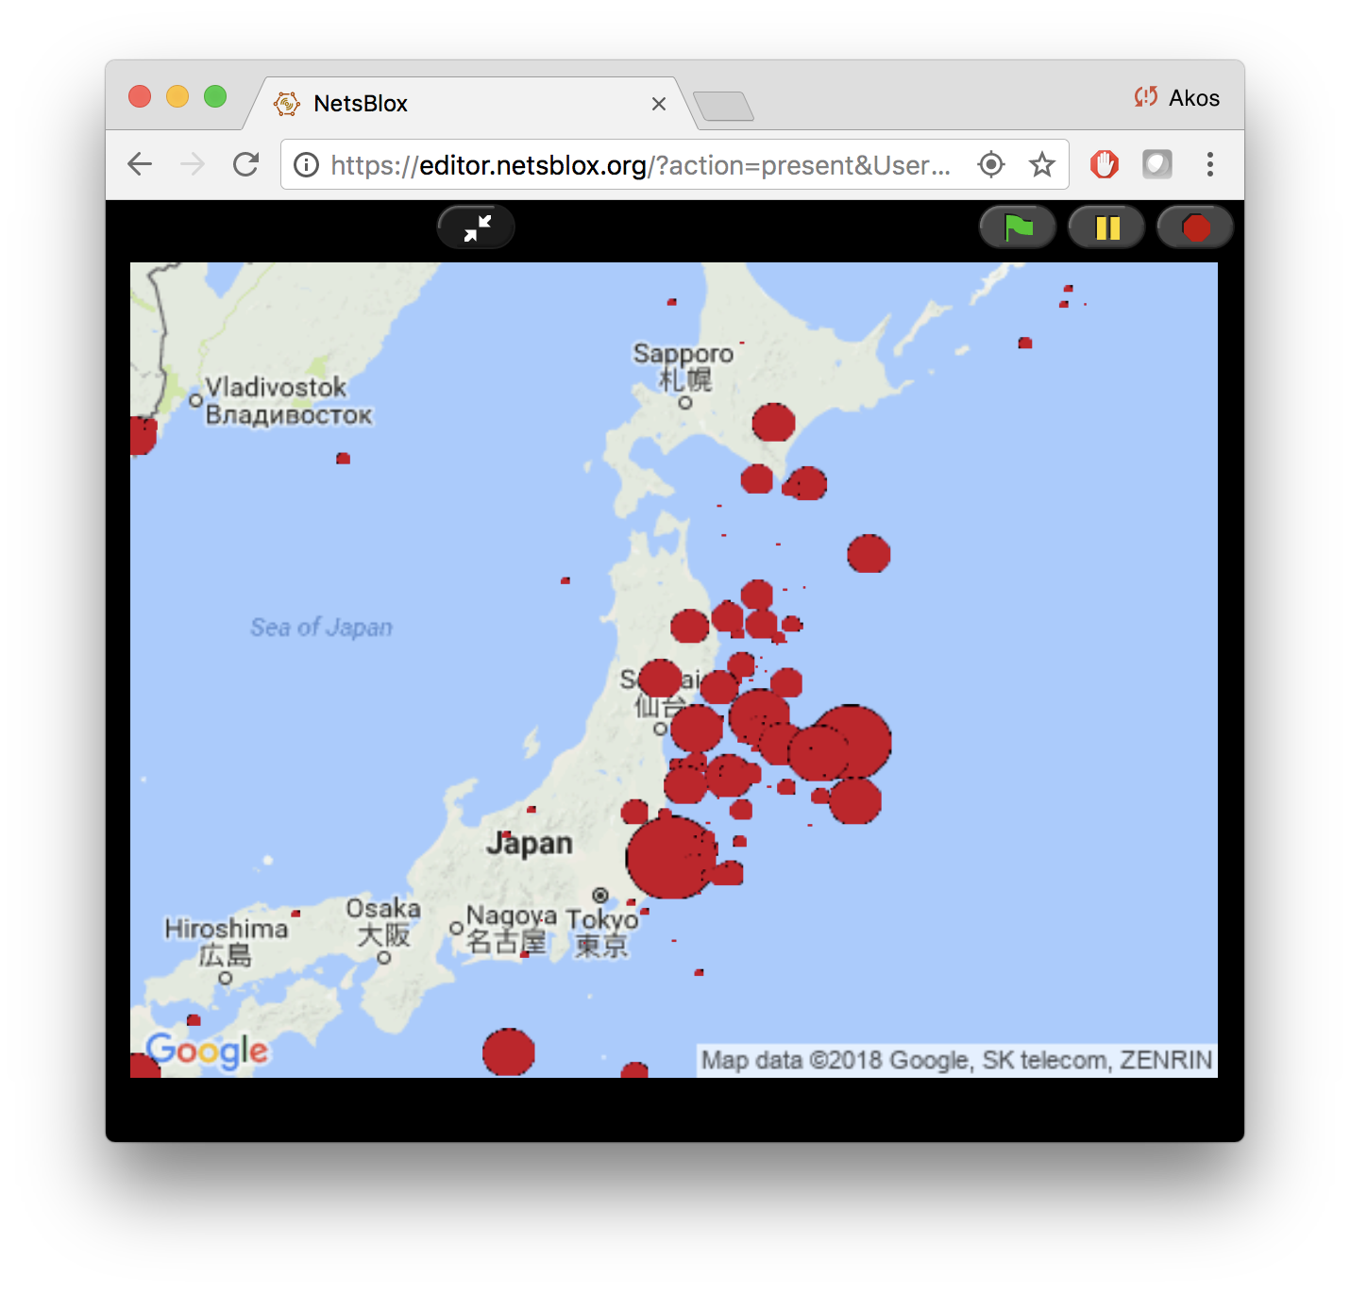
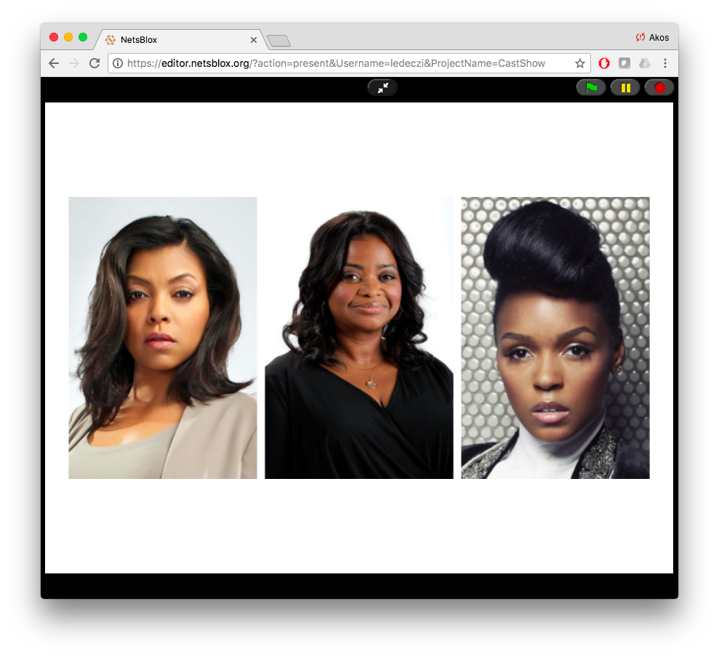
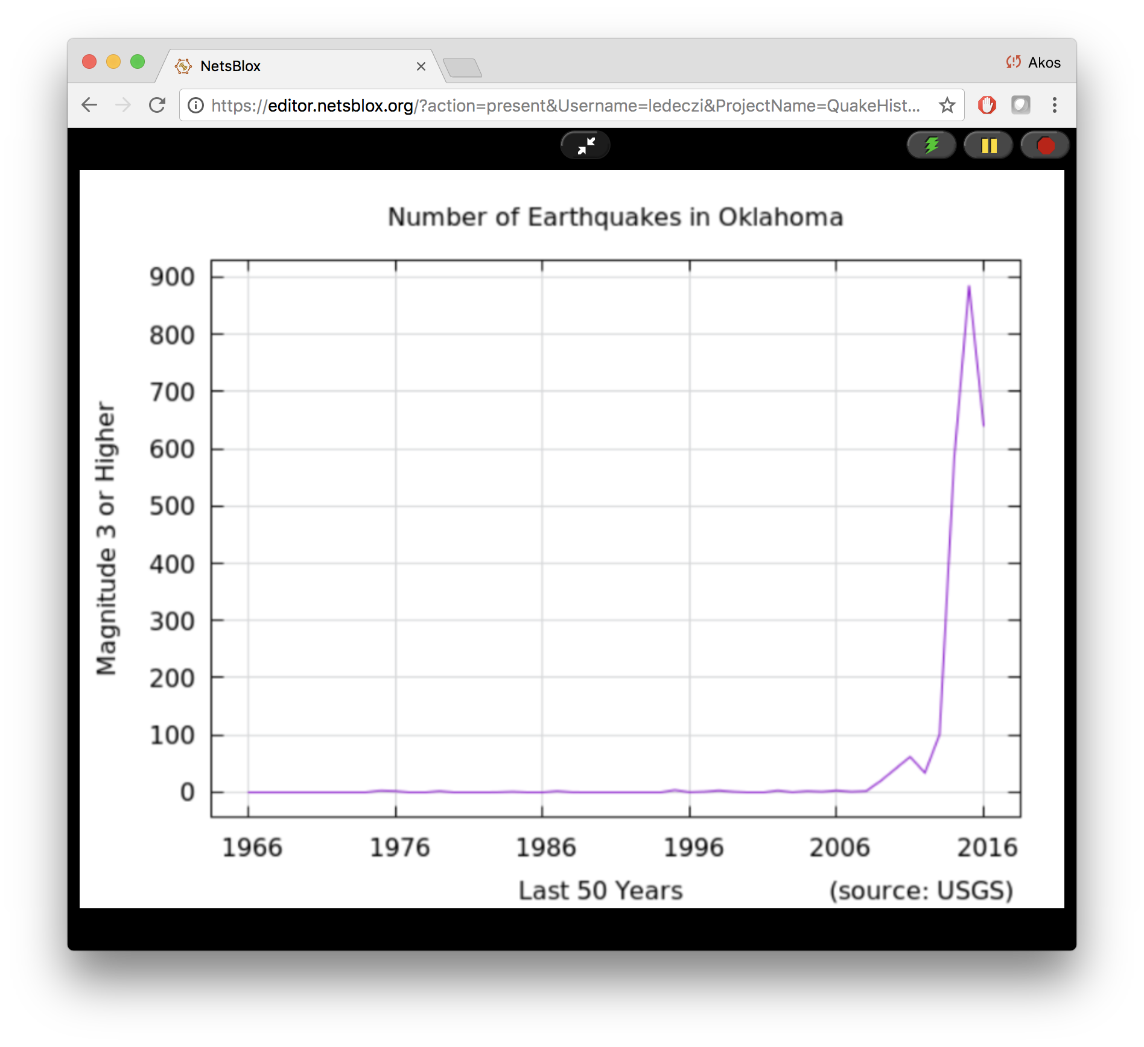
Additional RPC Demonstrations
Earthquakes for the past 10 years
3 leading cast members of any movie
Fracking?
Various other projects using online data sources and services

Slide 9
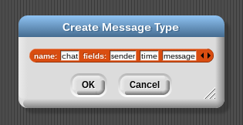
Message Passing
Similar to Events in Snap!
Carry data
Can go from one computer to another
Messages in NetsBlox (typed):
Message type editor:

Slide 10
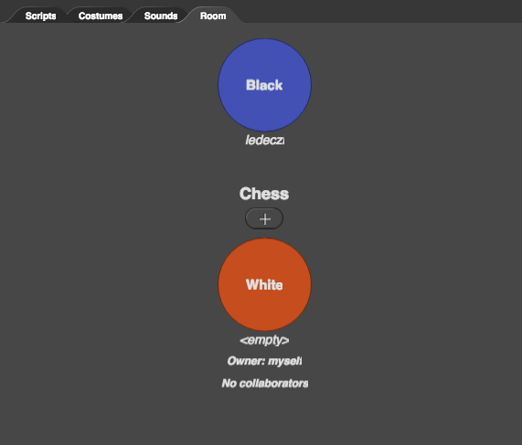
The Room
Set of roles/clients participating in the distributed application (subprojects)
Each role has its own set of sprites, stage and scripts
The owner invites other users to to run the project by “playing” a given role
Messages can be sent to these users (i.e., roles)
A new instance of the room is created for every new run of the application

Slide 11
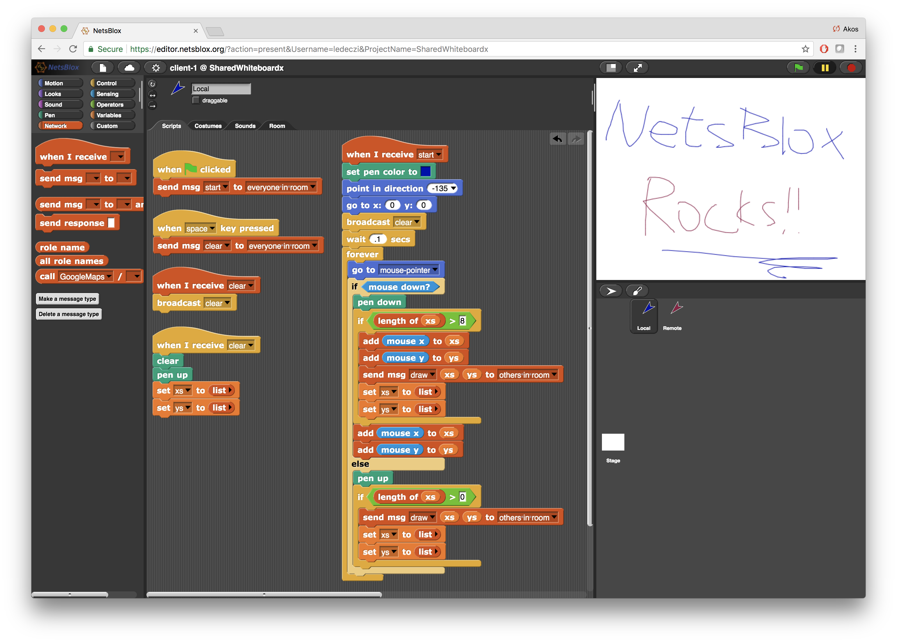
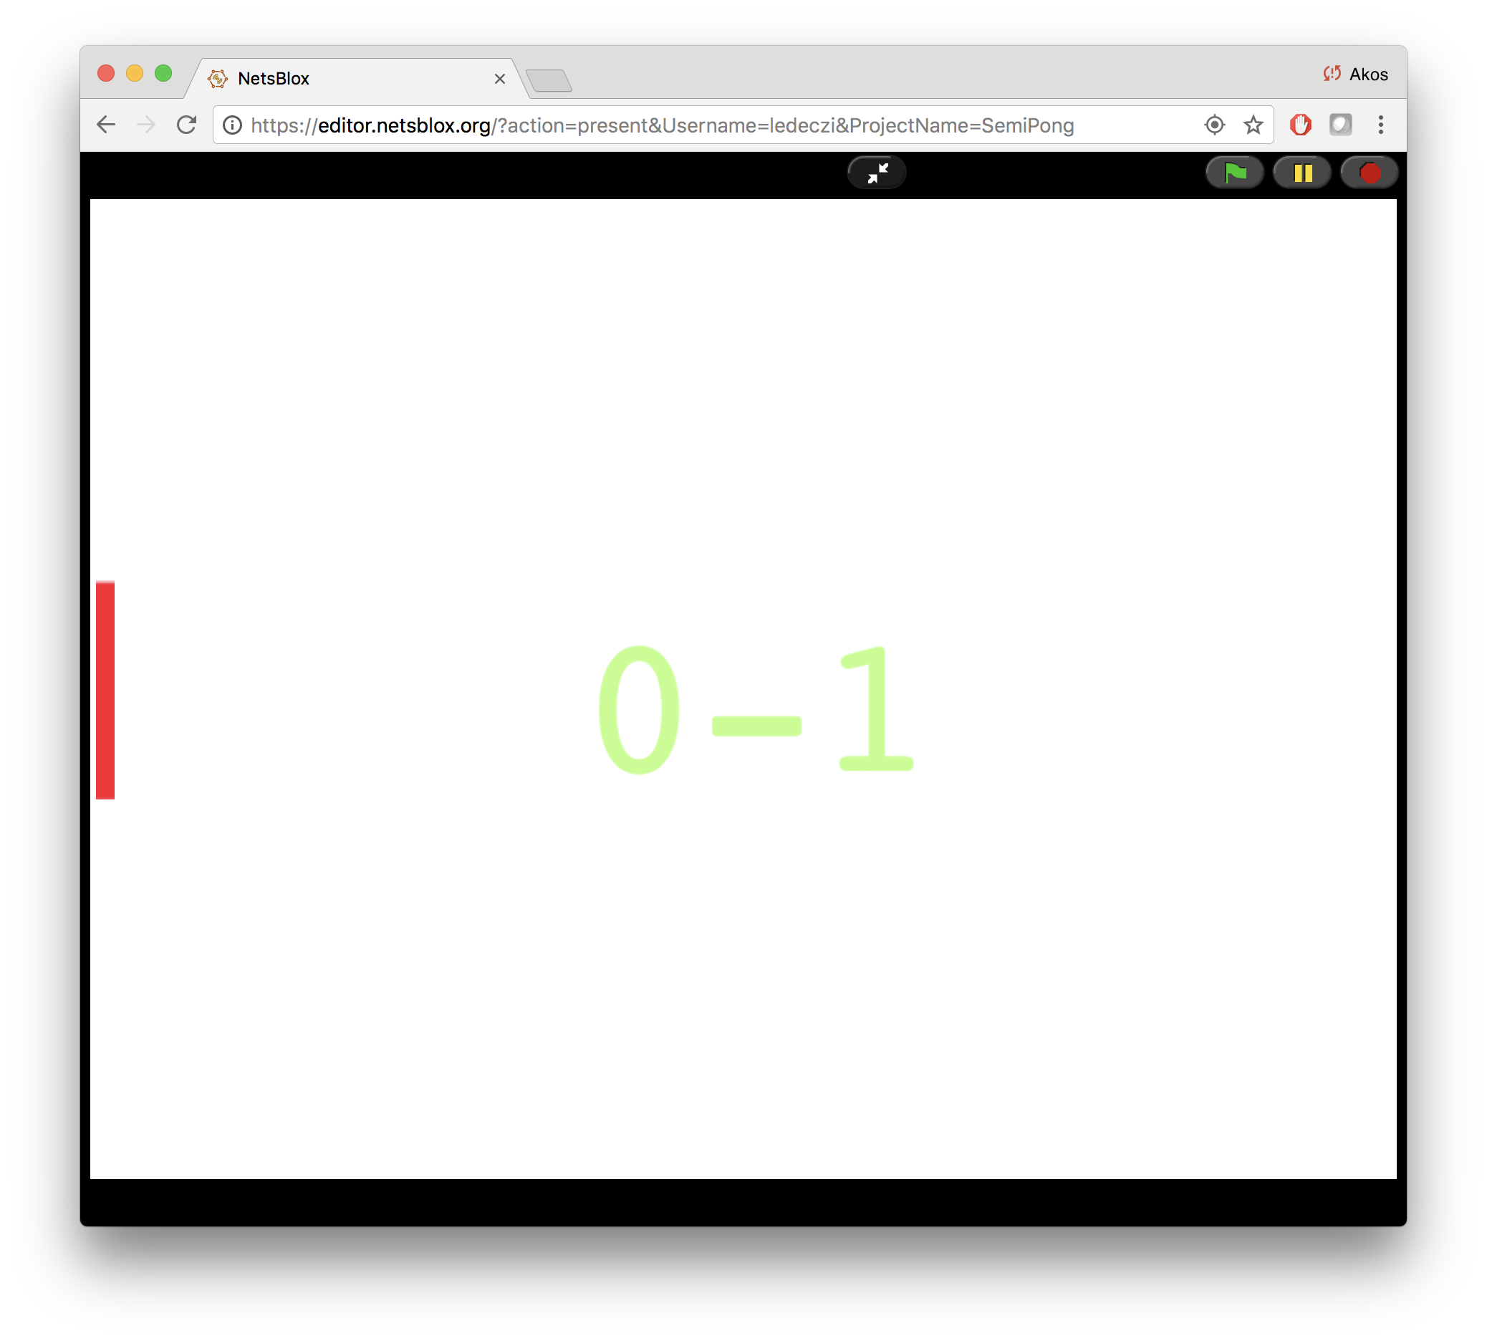
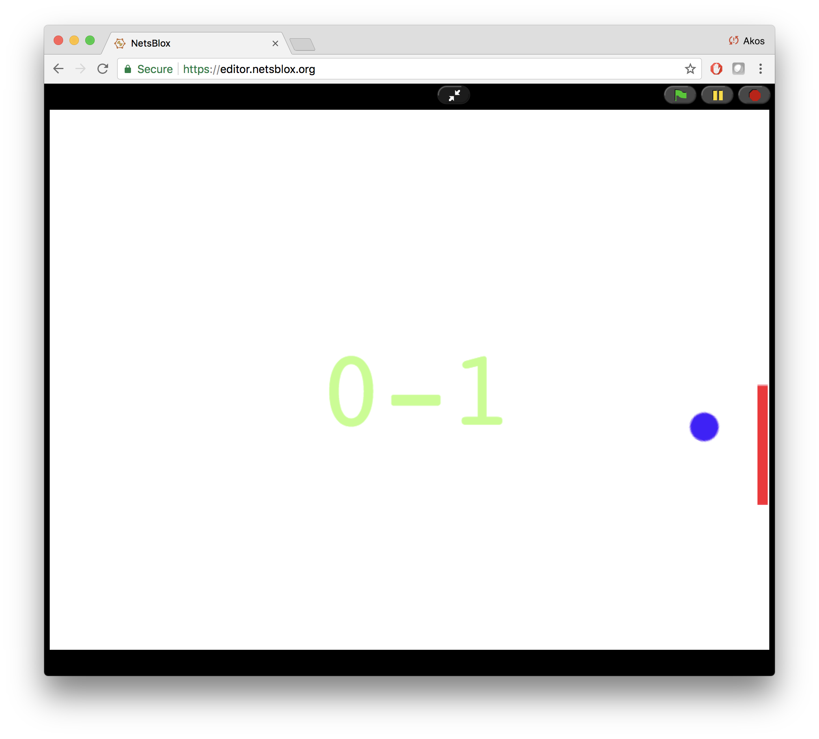
Message Passing Demonstrations
(Semi) Pong
Shared Whiteboard
Various distributed projects using message passing

Slide 12
Robotics with a Difference
NetsBlox program runs in the browser
Uses RPCs to control the robots via WiFi
No wires, no need to download the program: just like programming a sprite
Robot sends messages back with sensor values
Robot commands are sent in the clear, can be overheard: Various cyber attacks and cyber defense techniques can be taught in a hands-on manner.
Robot driving competition where other students are allowed to cyber attack the current racer
Two summer camps last year and two last month: level of engagement was off the charts

Slide 13
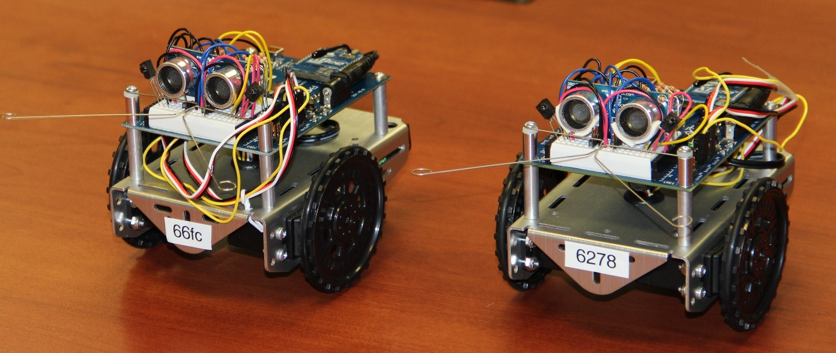
Parallax ActivityBot 360
WiFi enabled with an extra hardware module
MAC address used as unique ID (last four digits are enough)
Left and right wheel controlled independently
Sensors:
Ultrasonic range
Optical wheel encoders
Touch sensors (whiskers)

Slide 14
Robot Demonstration

Slide 15
Cybersecurity
How is RoboScape unsecure?
All communication is open
If you know the robot address, you have full access
Intentional and “faked:” we are not actually intercepting WiFi messages
Motivates cybersecurity:
Denial of Service attack
Encryption
Code breaking
Secure key exchange
Replay attacks
Week-long cybercamp
~30 hours (intensive, could be extended 2-3x easily)
No programming background assumed

Slide 16
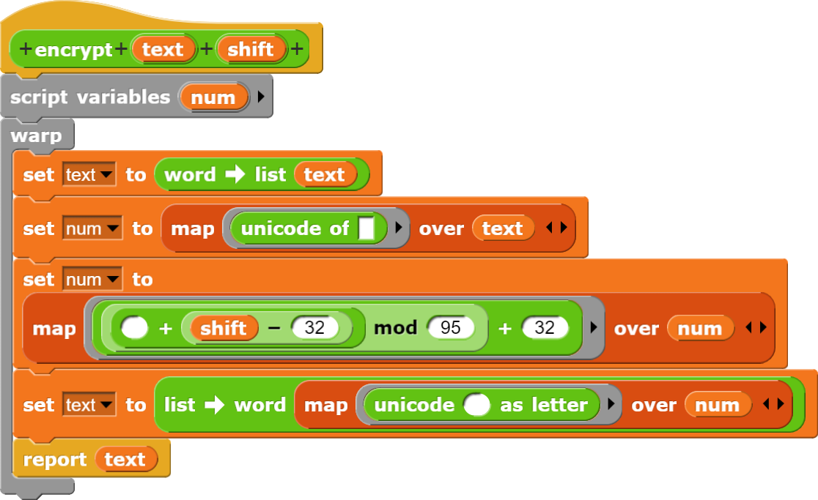
Encryption
Caesar's cypher
Custom blocks provided
Possible key values: 0-94
Robot defaults to 0
Make sure the RPC succeeds!!!

Slide 17
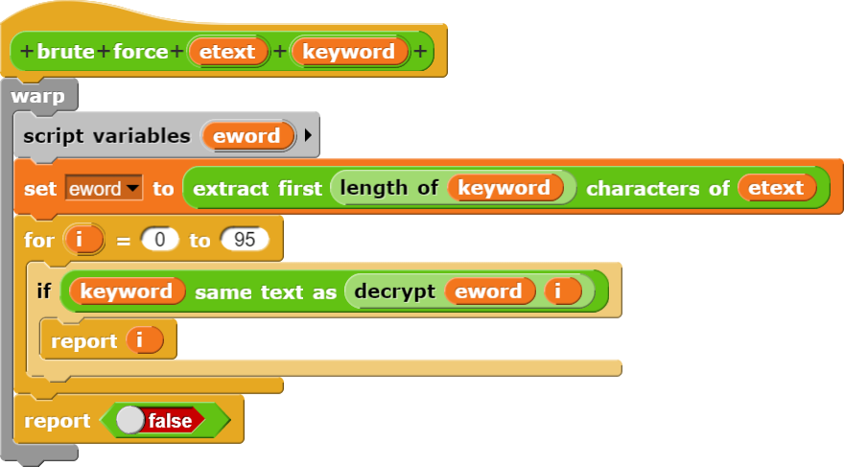
Brute Force Code Breaking
Look for one of the fixed keywords

Slide 18
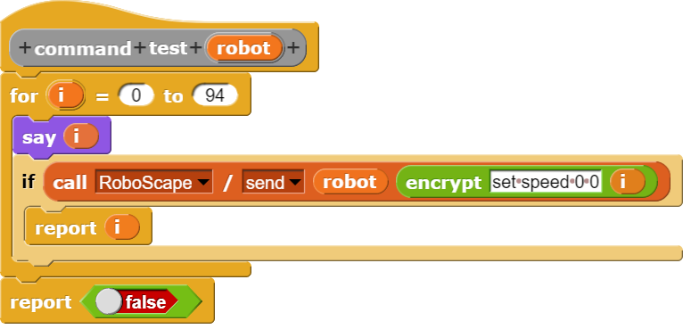
Brute Force Code Breaking
Test commands:

Slide 19
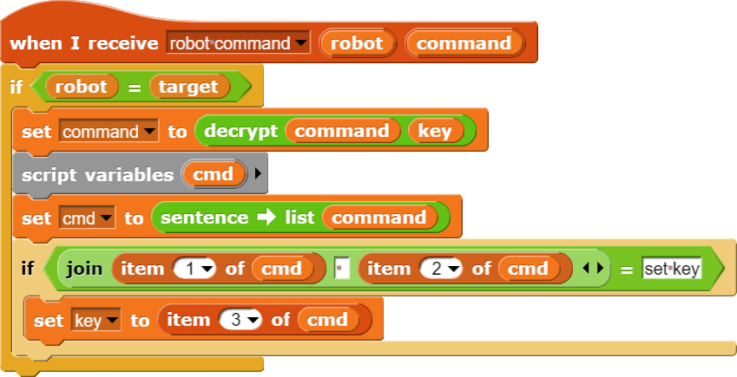
Key Theft
The first set key command is always unencrypted.
This code steals the key continuously:

Slide 20
Solution
Use stronger encryption:
Vigenère cipher: version of Caesar's with multiple keys
Speck by NSA
Secure key exchange:
Pressing the button on the robot generates a sequence of 16 bits and blinks the LEDs accordingly
4 4-bit keys for Vigenère (or Speck)
Type in values. Key is never broadcasted unecrypted
No need for the set key command! But can be used later for periodically changing the key

Slide 21
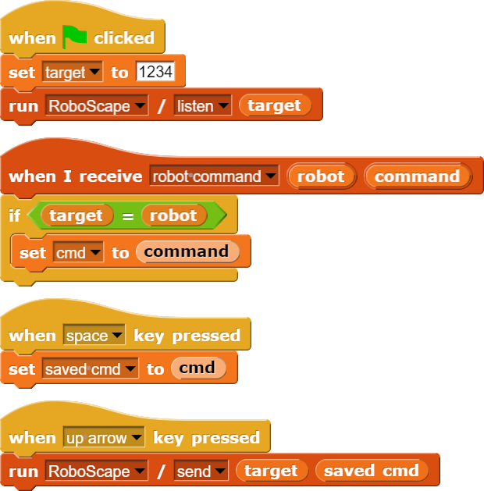
Replay Attack
Even if the attacker cannot break the encryption, they can still replay the last overheard command
Solution: sequence numbers:
The send command can be prepended by an integer: N
Once started, robot will only accept commands that start with a number M greater than the last one. Specifically:
N < M < N+100

Slide 22
What advanced CS concepts?
Distributed computing
Many concepts and examples shown
Distributed algorithms
Internet of Things
Computer Networking
Addressing, latency, unreliability, etc.
Mesh Networking
Communication Protocols
Data structures
Lists
Multi dimensional data
“Big data”
Parallel Computing
Embarrassingly parallel problems
Robotics
Cybersecurity

Slide 23
Collaboration
Code editing a la Google Docs
Pair programming
Group projects
What is synchronized?
Everything that does not change by running the program
Sprites and scripts
What is not synchronized?
Everything that change by running the program
The state of the stage and sprites (location, orientation, etc.)
Variable values
Users can work together on the program but each executes it on his/her computer independently

Slide 24
Summary
NetsBlox opens the internet for students’ programs
Public data sources related to STEAM
Distributed programming/computer networking
Robotics and cybersecurity
Other advanced concepts
Collaboration
Hands-on: learning by doing
More engaging projects increasing motivation
Allows for synergistic teaching of STEM and CT
High ceiling:
Can be used to teaching advanced topics that no other environment allows currently

Slide 25
Questions?
https://netsblox.org
https://netsblox.org/cybersecurity
Do not forget to fill out the evaluation!
Sponsors: National Security Agency, National Science Foundation and
Vanderbilt University

